Slide 1


ONLINE PAYING GUEST
MANAGEMENT SYSTEM
Name:- Shubhangi Hingu
Enrollment no:-181250107009
BE:- Computer
Semester:- 8th
Internal guide : Dr. Ramesh Prajapati

Slide 2
CLICK DOT PG

Slide 3
OVERVIEW
Abstract
Drawbacks of exciting system
All Modules
Exciting v/s Proposed system
Result analysis and discussion
System requirements
Diagrams
Project screen shots
Database tables

Slide 4
Paying Guest Accommodation System
As the name specifies “PAYING GUEST ACCOMODATION SYSTEM” is a software developed for managing various activities in the PG.
User need to specify their requirement the system will match the user requirement with the details in the database and after finding the match the required details are given to the user.
The system will have a Admin page from which he can add details about the rooms.
This will reduce the effort required by the new students and existing student in searching room and other useful things.

Slide 5
We can improve the efficiency of the system, thus overcome the drawbacks of the existing system :
Less human error ·
Strength and strain of manual labour can be reduced.
High security.
Data redundancy can be avoided to some extent.
Data consistency.
Easy to handle.
Easy data updating.
Easy record keeping
Backup data can be easily generated.

Slide 6
In PGAS project we use PHP and MYSQL database. It has three modules.
Admin Module
PG Owner Module
User Module
Admin Module
Dashboard: In this section, admin can see all detail in brief like total state, total city, total owner and total pg.
State: In this section, admin can manage state(add/update).
City: In this section, admin can manage city(add/update).
Reg Owner: In this section, admin can view and edit registered owner.
PG Details: In this section, admin can view PG detail which is listed by PG owner.
Pages: In this section, admin can manage about us and contact us pages
Admin can also update his profile, change password and recover password.

Slide 7
PG Owner Module
Dashboard: In this section, owner can see all detail in brief like total listed pg, total booking, total new booking, total confirmed booking and total canceled booking.
List Your PG: In this section, owner can list their pg.
Received Booking Request: In this section admin can view new booking and he has right to confirmed booking.
Search: In this section, owners can search booking request by booking number.
Notification: In this owner can seen notification of booking.
Owner can also update his profile, change password and recover password

Slide 8
User Module
In this module the reins two types of user guest user and registered user.
Guest User: In this guest user can see only general information like about us, pg details, search pg and contact details.
Registered users can do following activity :
1. Book the pg.
2. Update his/hers ownprofile.
3. Change Password.
4. Registered user can also recover his/her own password.

Slide 9
EXISTING VS PROPOSED SYSTEM
The process of finding accommodation was relatively very difficult and made it trouble for students and parents to find room in campus thus to overcome this portal was designed:
i. There is no such existing system presently and this made is difficult
ii. The searching process included a lot of hardship and wastage of time.
iii. The proposed system is completely new concept that will be helpful to students and parents .
iv. The proposed system makes a great database of all the accommodation of the campus thus can be used for other purpose too.
v. The proposed system is quiet secure as only admin is allowed make any entry to it .

Slide 10
RESULT ANALYSIS AND DISCUSSION
Analysis a process of gathering and interpreting facts, diagnosing problems and the information about the PG Management System to recommend improvements on the system.
System analysis is concerned with becoming aware of the problem, identifying the relevant and decisional variables, analyzing and synthesizing the various factors and determining an optimal or at least a satisfactory solution or program of action.

Slide 11
Hardware Configuration
Pentium IV Processor
512 MB RAM
40GB HDD
1024 * 768 Resolution Color Monitor
Software Configuration
OS : Windows XP
PHP Triad (PHP, MySQL, Apache, and PHPMyAdmin, PDO)

Slide 12
What do we offer?
MEAL
PARKING
BEST MEAL FOR GUEST
PARKING FOR VEHICLES
PG ROOM
LIVE
RECORD
BOOK SHELF
EASY TO LIVE WITH EACHOTHERS
ROOMS
RECORD DATA WITH VERY CLEAN
ALL BOOKS NEES TO READ

Slide 13
OUR FEATURED PG
We are a set of well-selected and chosen Paying Guest services. This is a platform where those, who are willing to open their homes to guests, meet the people looking for wonderful homes to stay in and not have to look for hotels or favors in any city for their long stays.

Slide 14
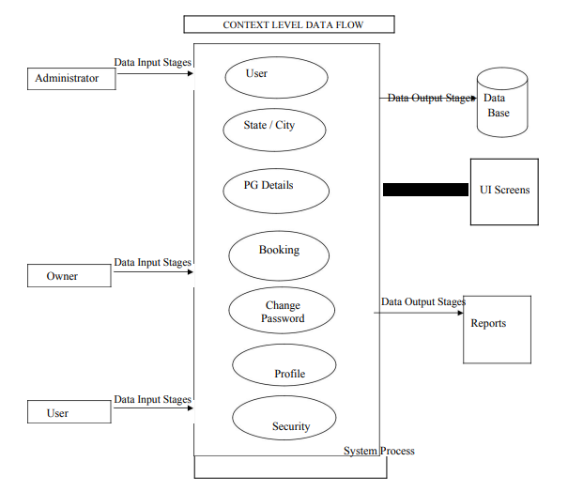
DFD FOR CONTEXT LEVEL

Slide 15
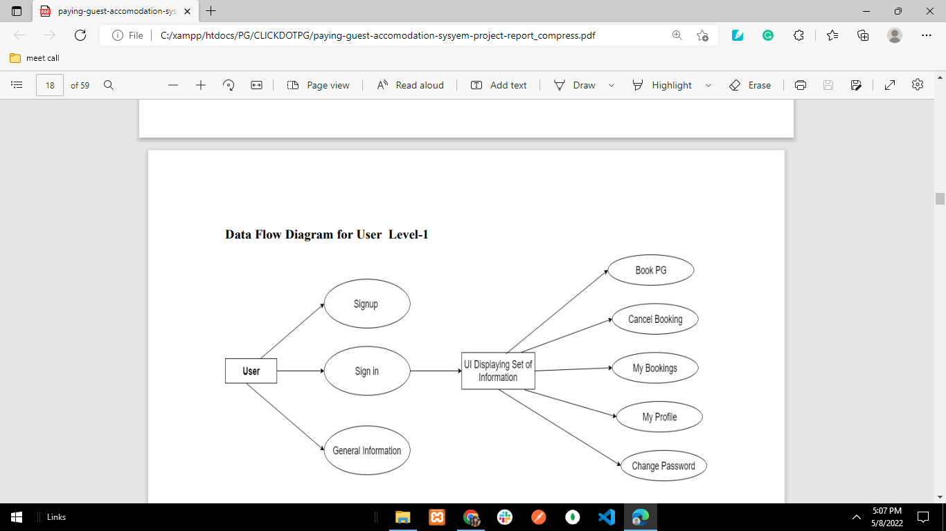
DFD FOR USER LEVEL

Slide 16
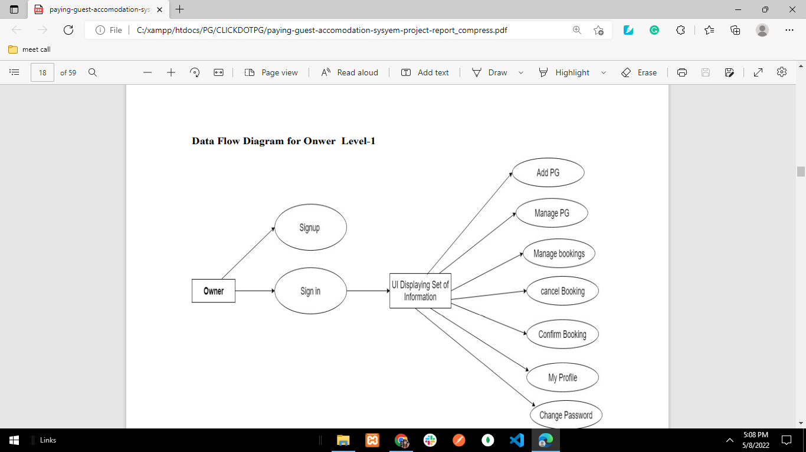
DFD FOR OWNER LEVEL

Slide 17
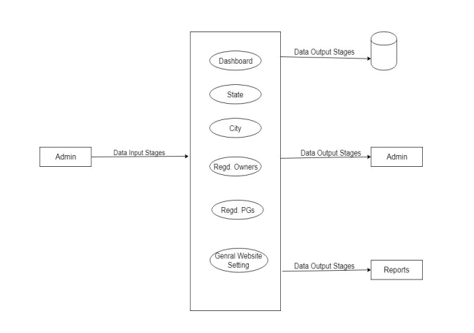
DFD FOR ADMINISTRATOR LEVEL

Slide 18
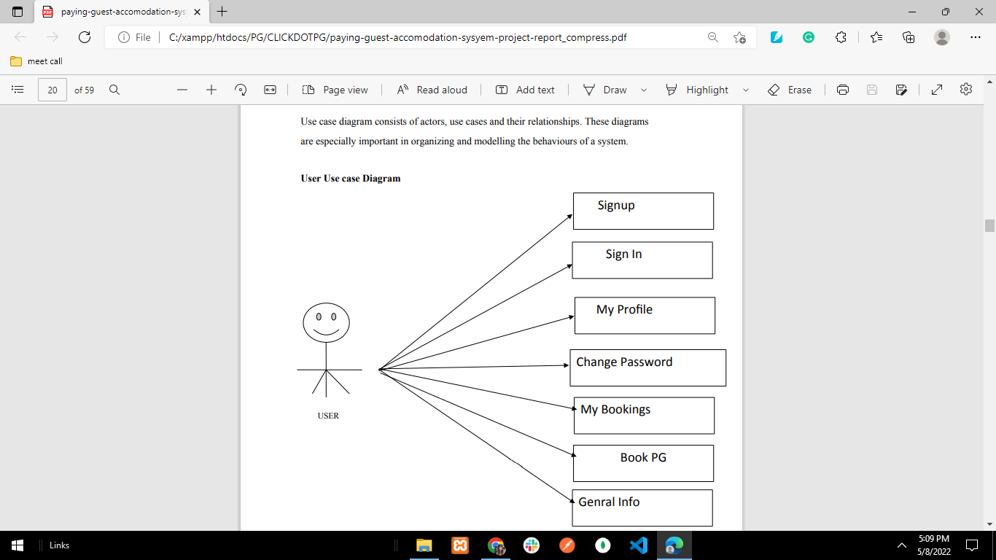
USER USE CASE

Slide 19
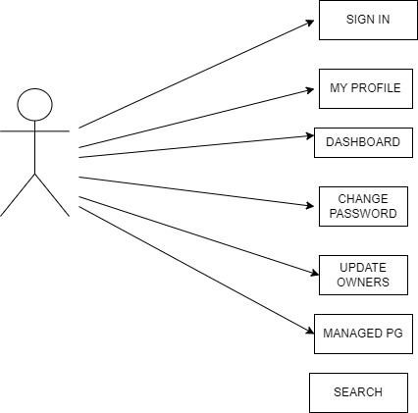
OWNER USECASE

Slide 20
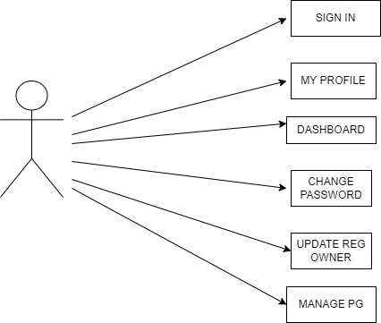
ADMIN USECASE

Slide 21
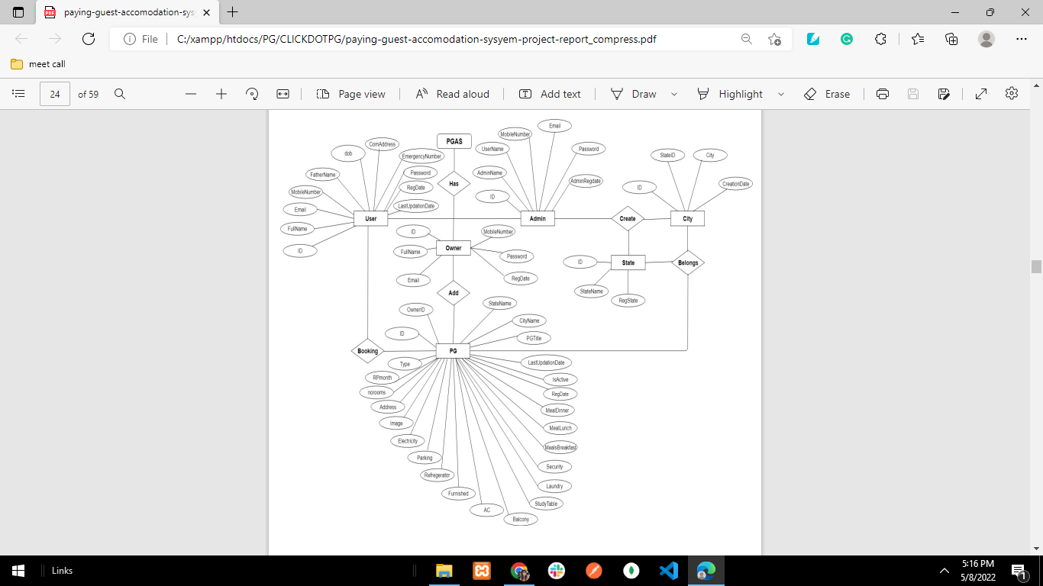
E – R DIAGRAM

Slide 22
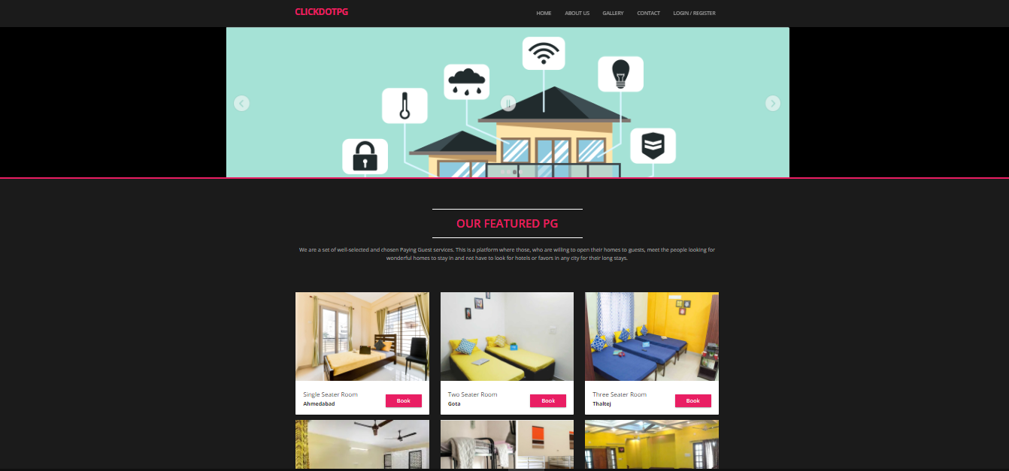
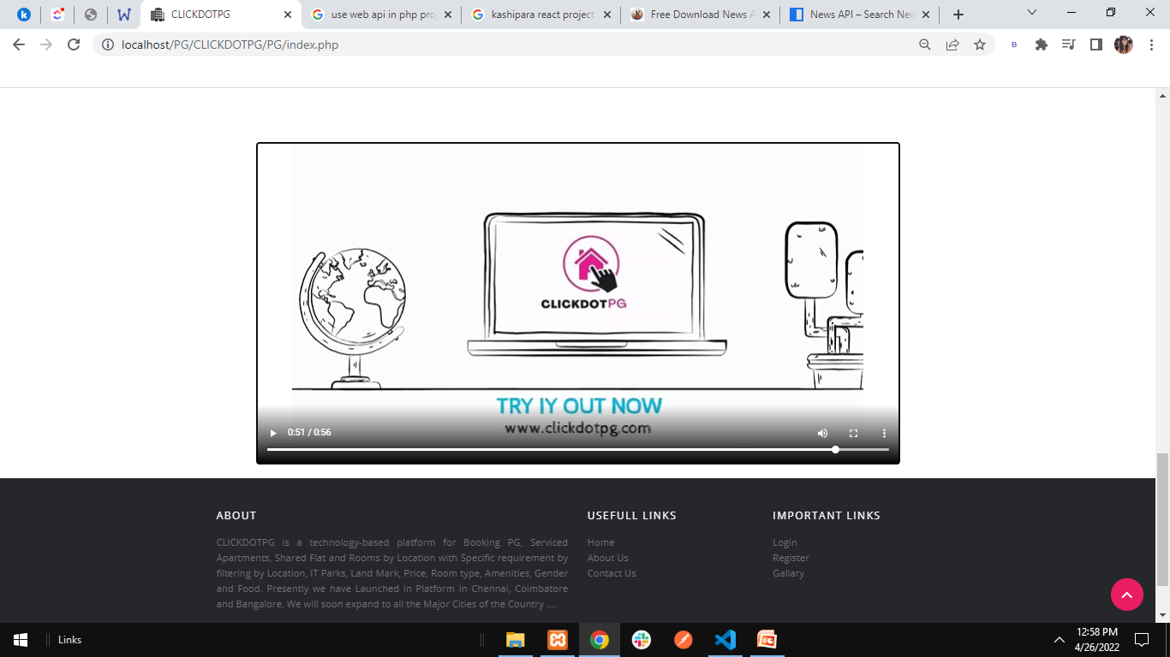
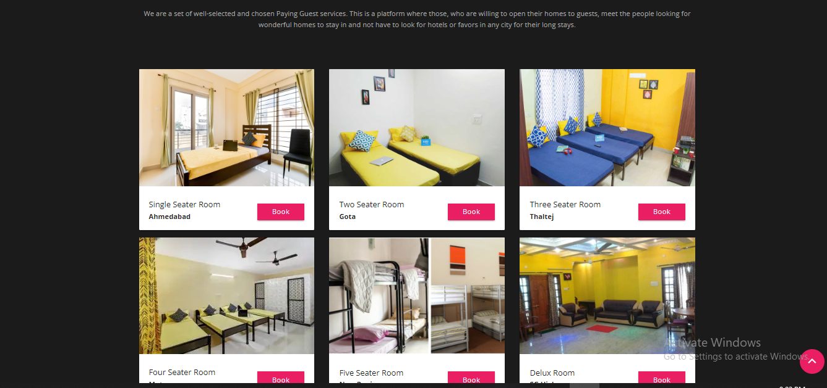
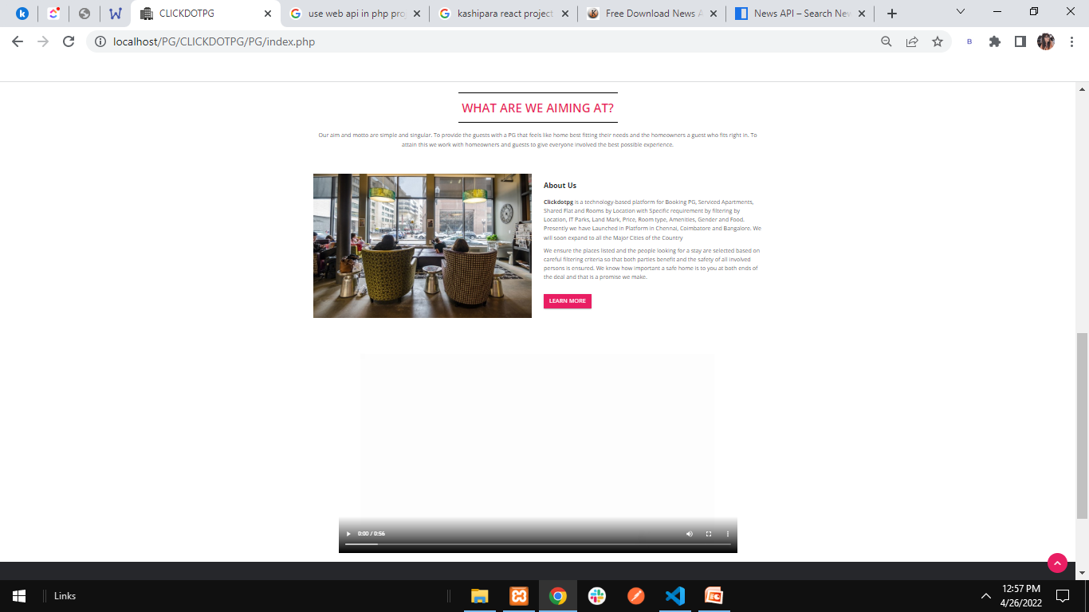
Index.php

Slide 23
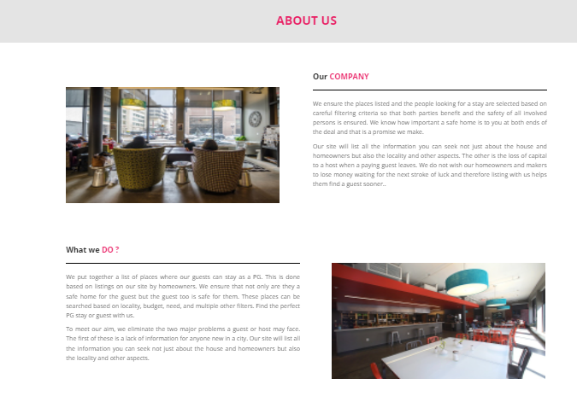
ABOUT US

Slide 24
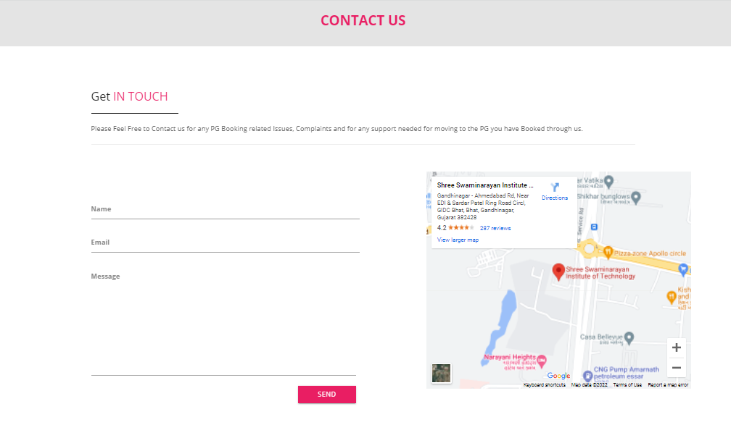
CONTACT US

Slide 25
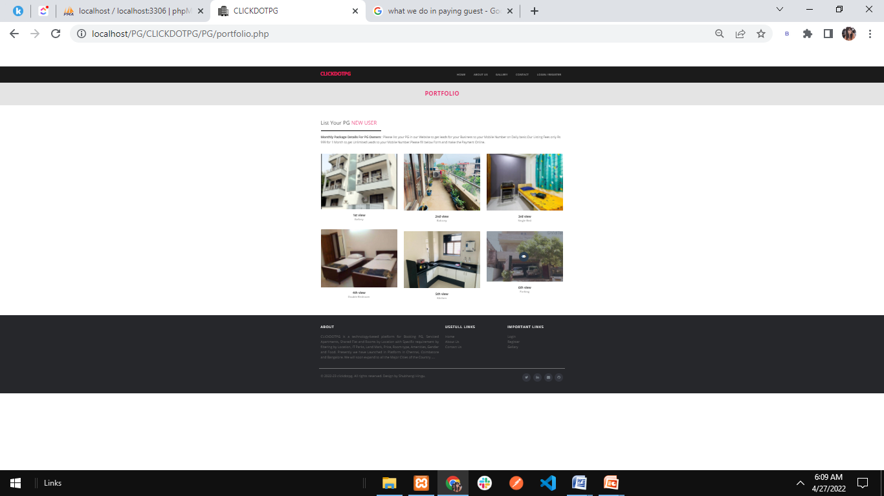
PORTFOLIO

Slide 26
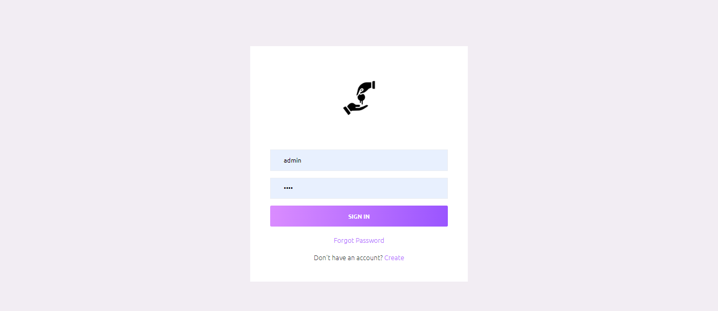
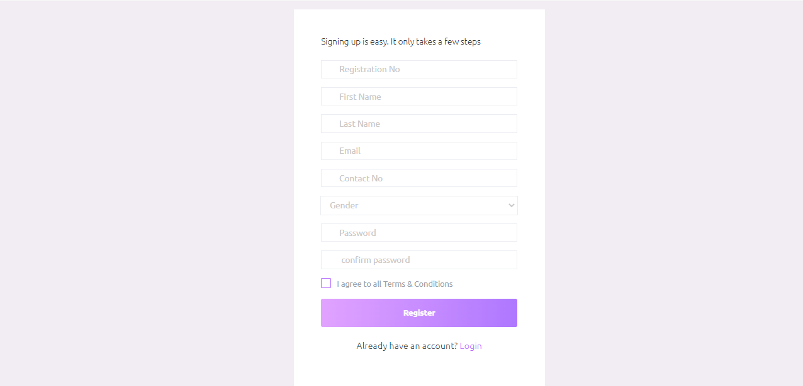
User login
User registration

Slide 27
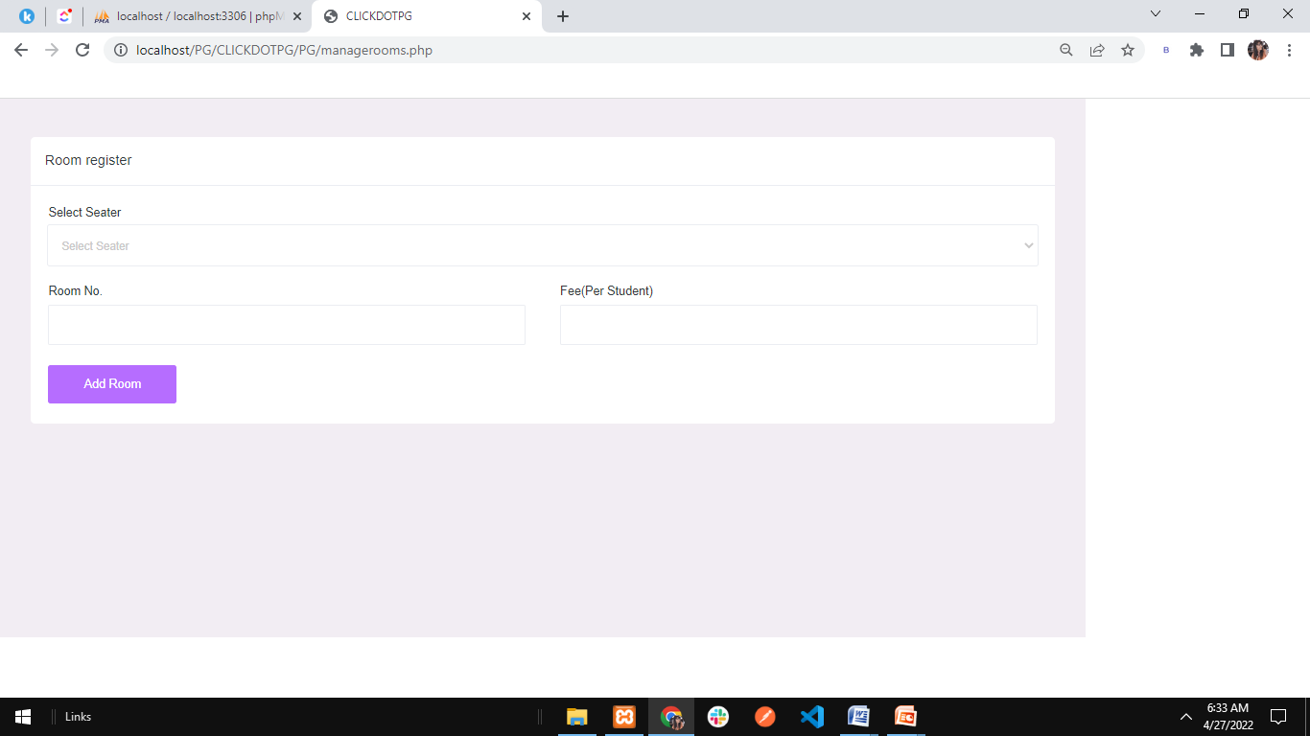
Book PG Room

Slide 28
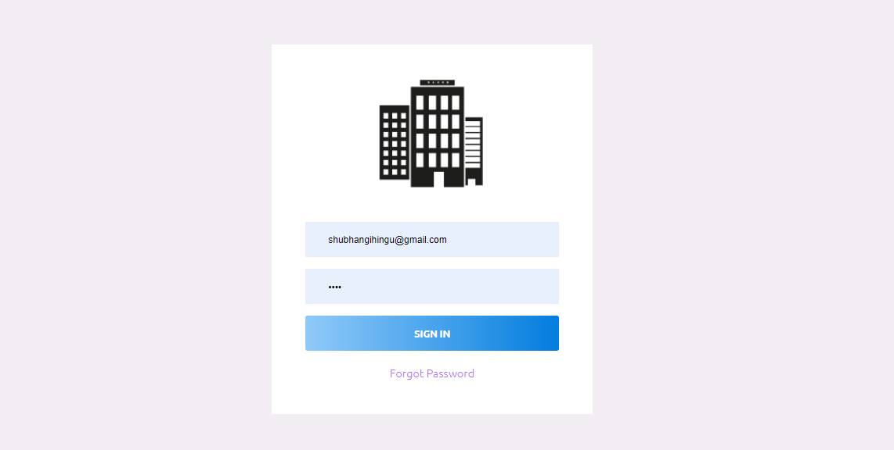
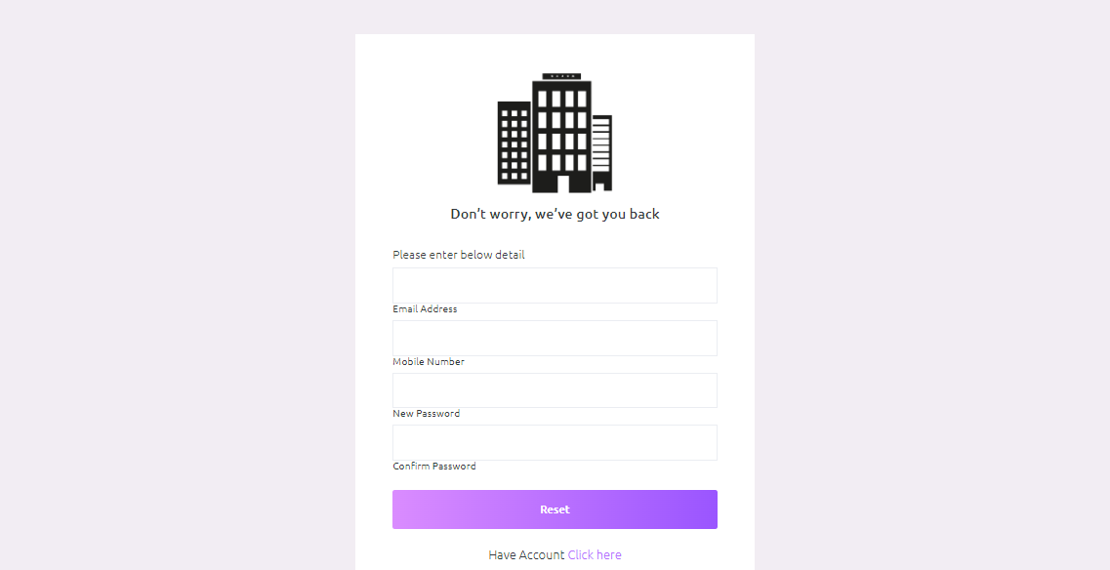
Admin login
Forgot password

Slide 29
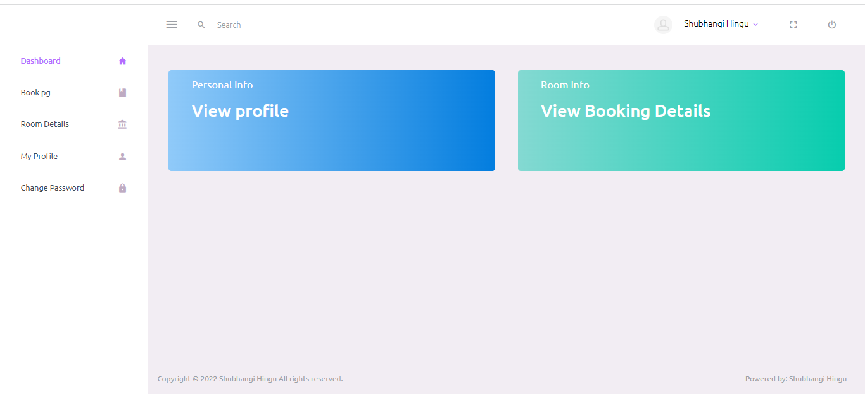
User : dashboard

Slide 30
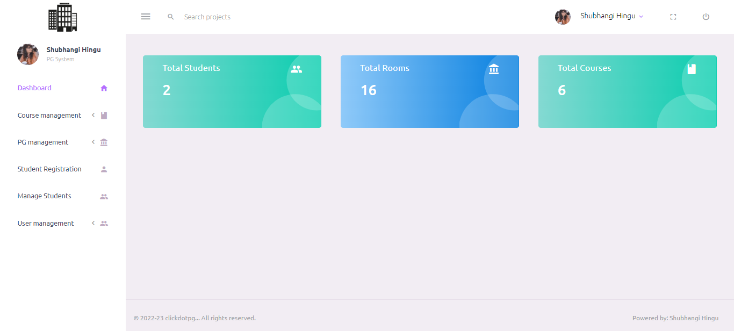
Admin : dashboard

Slide 31
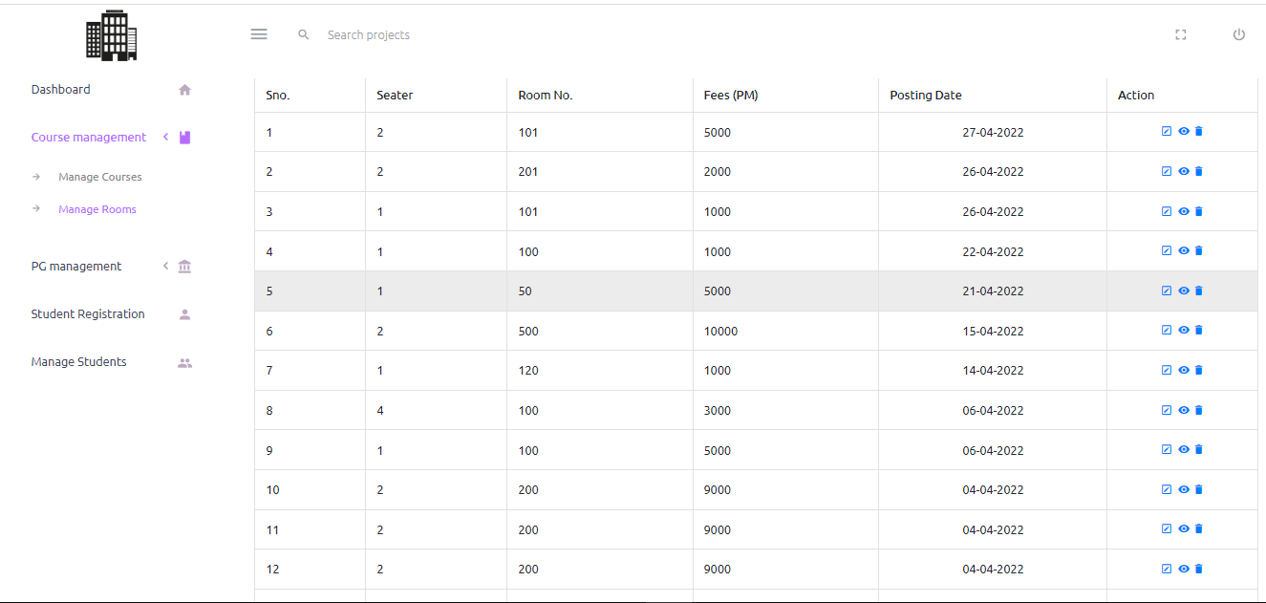
Admin mange rooms

Slide 32
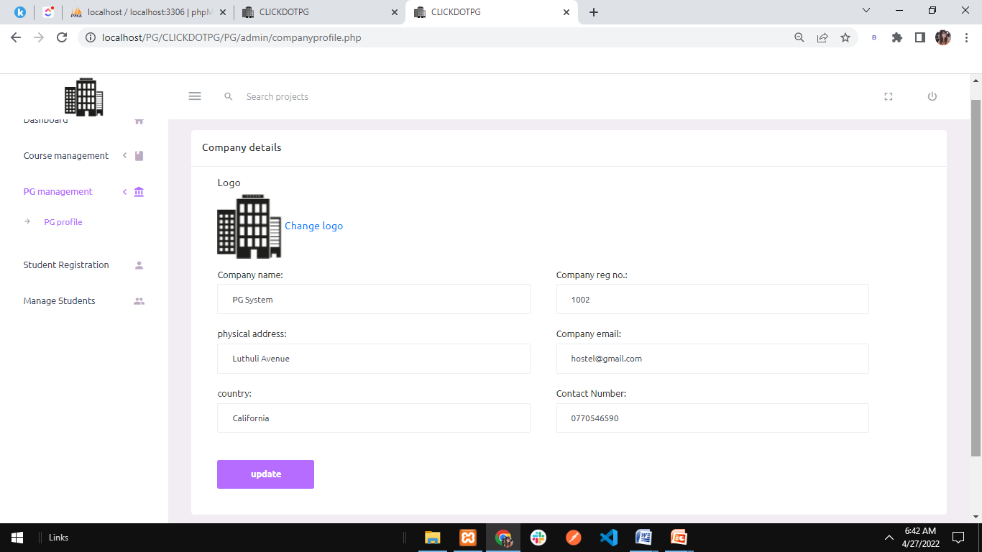
Pg profile

Slide 33
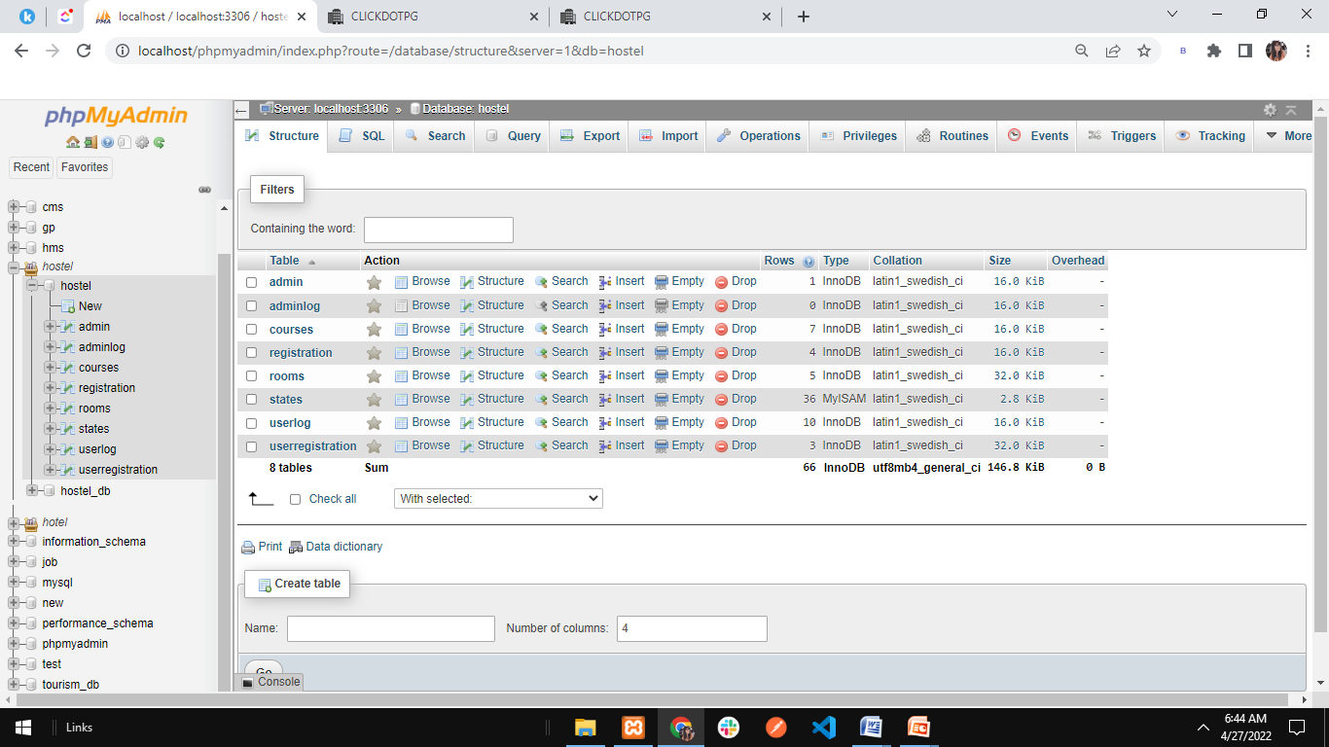
Database

Slide 34
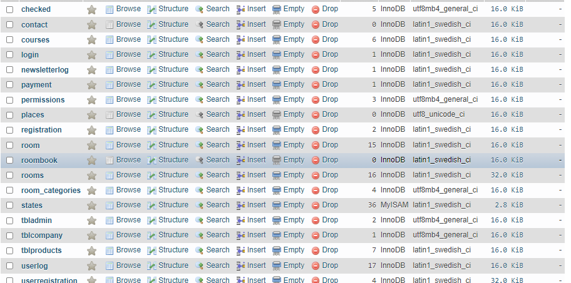

Slide 35
Connect with us
Please Feel Free to Contact us for any PG Booking related Issues, Complaints and for any support needed for moving to the PG you have Booked through us
Email : shubhangihingu@gmail.com
Phone no. : 7096289031

Slide 36
« A COMFORT ZONE IS A BEAUTIFUL PLACE BUT NOTHING EVER GROWS THERE »

Slide 37
Thanks!

